Slide 1

RESUME CLASSIFICATION
GROUP-2

Slide 2
Sanket Kshirsagar
Team members
Abhijit Lavhale
Chetlapalli Harsha
Anshul Sahare

Slide 3

Objective
Architecture
Dataset Detail
Agenda
Data cleaning
Visualization
Model Evaluation
Finalised Model
Deployment

Slide 4

Objective
To explore the use of machine learning and natural language processing for organizing and classifying resumes into relevant job categories, with the goal of enhancing efficiency in resume screening processes.

Slide 5
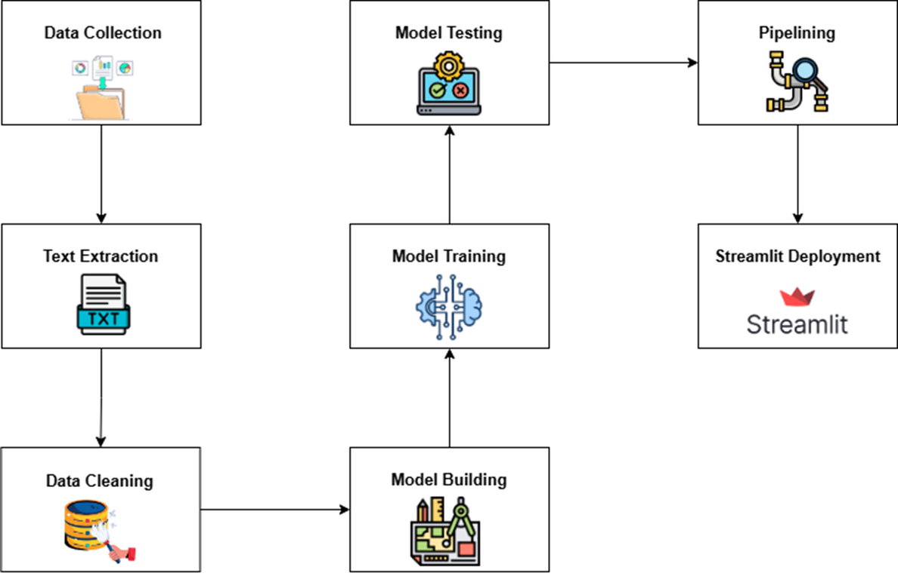
ARCHITECTURE

Slide 6

Dataset Detail
The dataset used for the resume classification project comprises resumes grouped into four distinct job categories:
•React Developer – 30 resumes
•Workday – 27 resumes
•PeopleSoft – 25 resumes
•SQL Developer – 18 resumes
Each category is stored in a separate folder, providing a clearly labeled structure ideal for supervised machine learning tasks. The resumes are in a variety of commonly used formats, including:
•PDF (.pdf)
•Microsoft Word (.docx and .doc)

Slide 7
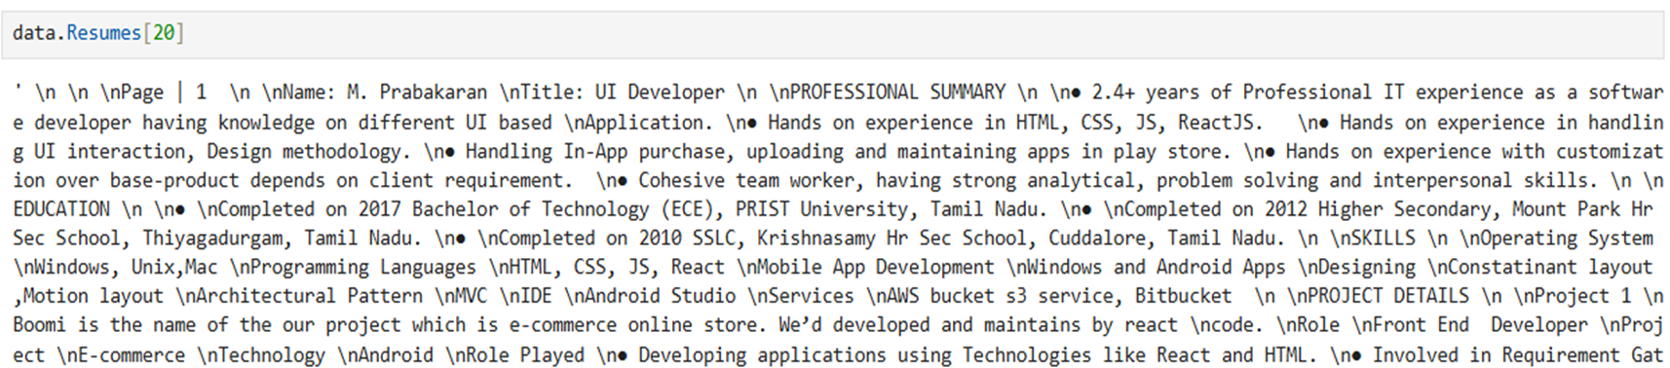

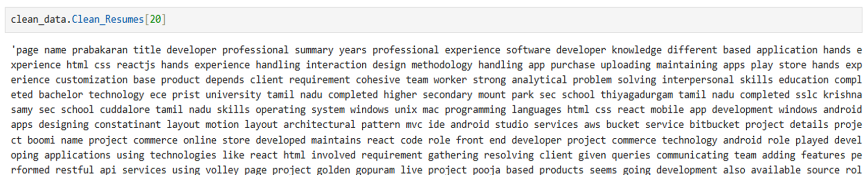
Data cleaning
Before
After

Slide 8
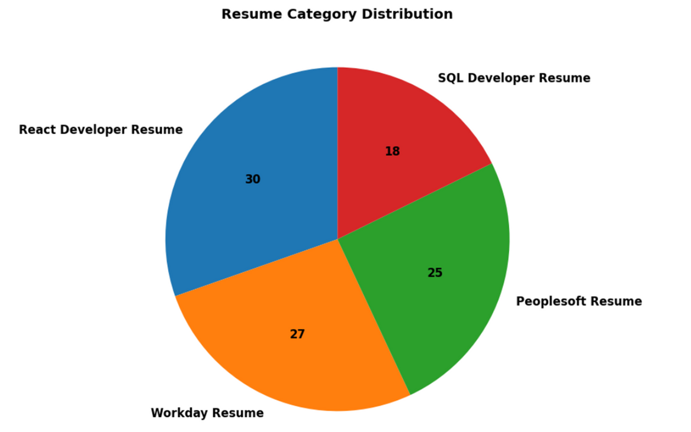
RESUME CATEGORY DISTRIBUTION

Slide 9
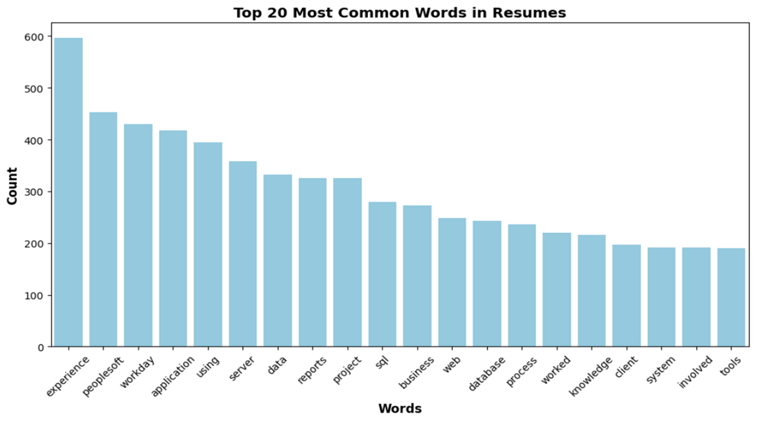
TOP 20 MOST COMMON WORDS

Slide 10
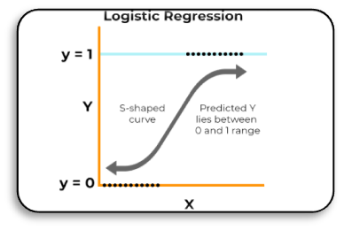
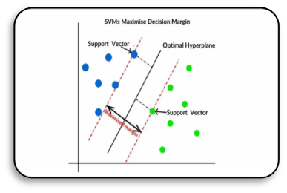
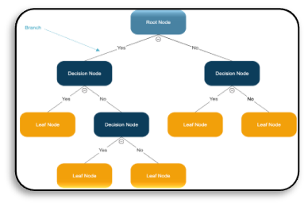
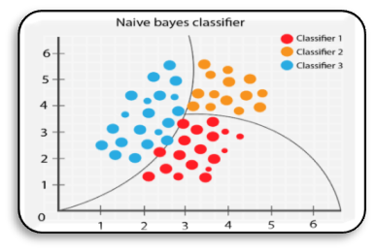
Models
Logistic Regression
Support Vector Machine
Decision Tree
Naive Bayes

Slide 11
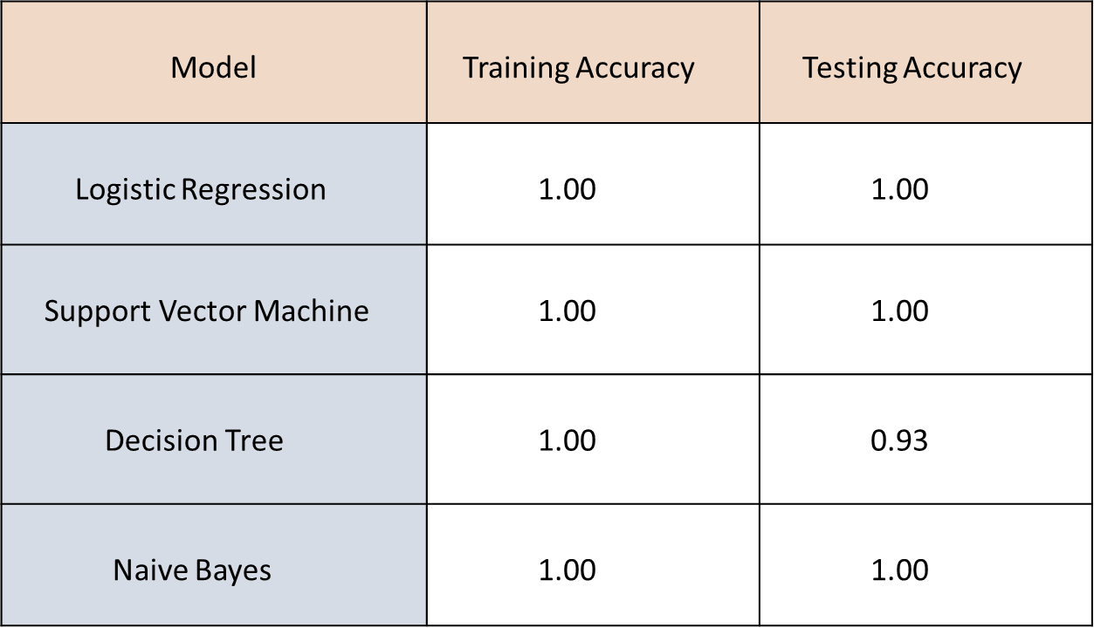
MODEL EVALUATION

Slide 12
FINALISED MODEL : NAIVE BAYES (MULTINOMIAL)
Achieved 100% accuracy on both training and testing data
Fastest training time among all tested models
Performs well with TF-IDF vectorized text data
Efficiently handles high-dimensional feature spaces
Easy to interpret and implement for text classification

Slide 13
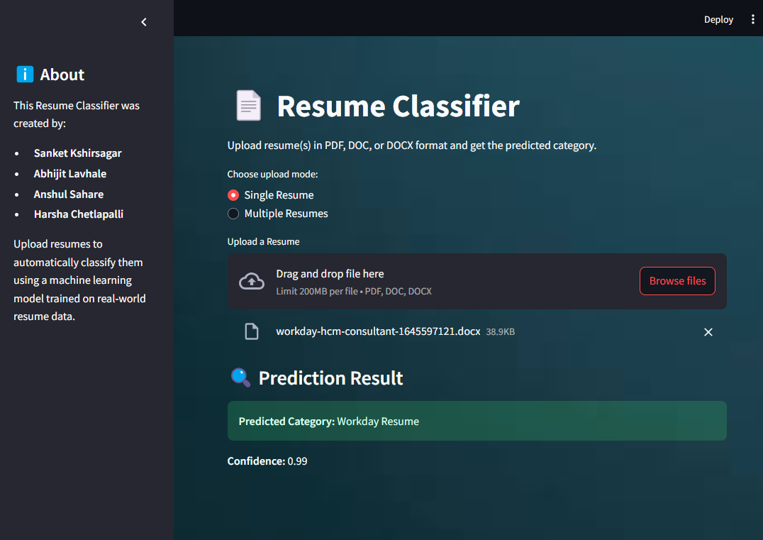
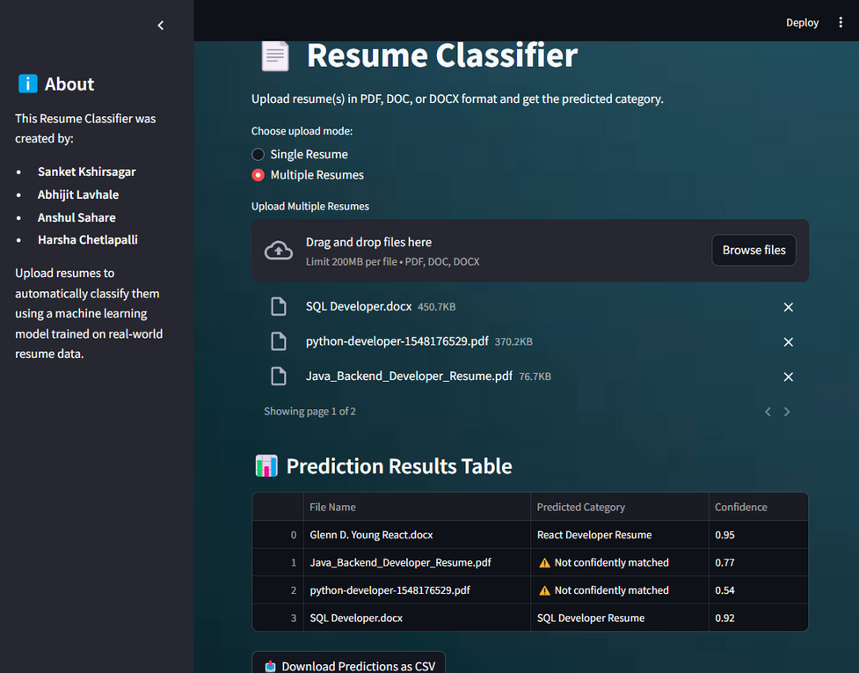
DEPLOYMENT
By using the Streamlit framework, we deployed the Naive Bayes resume classification model and built an interactive web application.
Users can upload single or multiple resumes in PDF, DOCX, or DOC formats, and the model instantly classifies them into the correct category.

Slide 14
Thank You
Thank you very much!

